Slide 1
Sellhub

Slide 2
Summary
Providing a platform for users to sell, buy or trade goods with other users over the internet.
Finalized our Strategy, Scope and Structure of the website
Created information architecture considering information about various aspect of the proposed product
Wireframes using Balsamiq

Slide 3
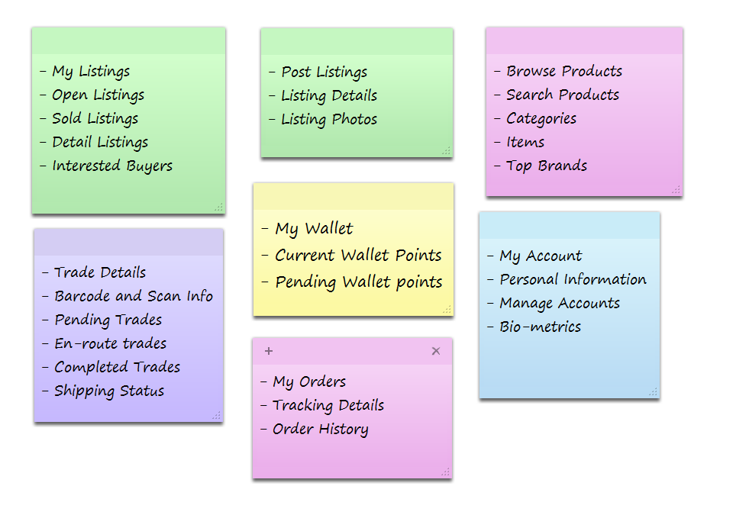
Card Sorting

Slide 4
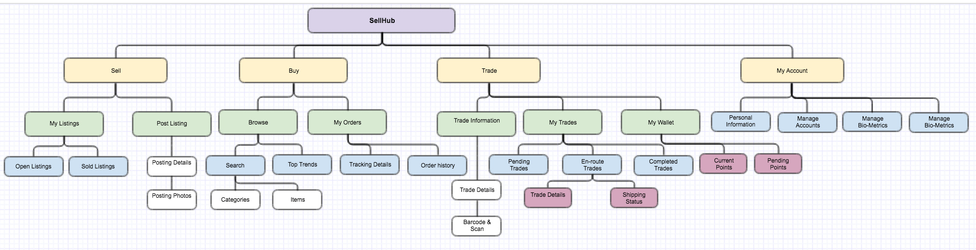
Information Architecture

Slide 5
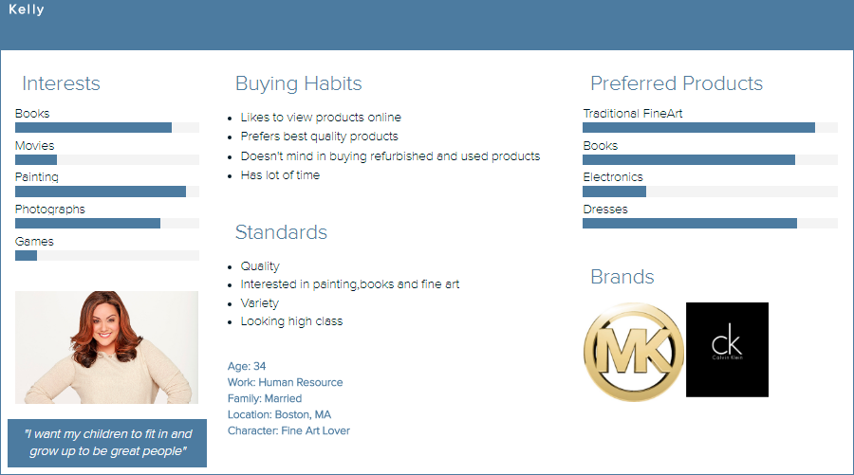
User Personas

Slide 6
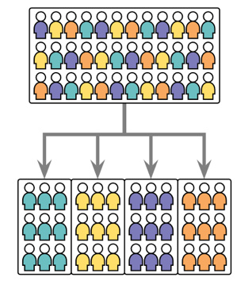
User Segmentation

Slide 7
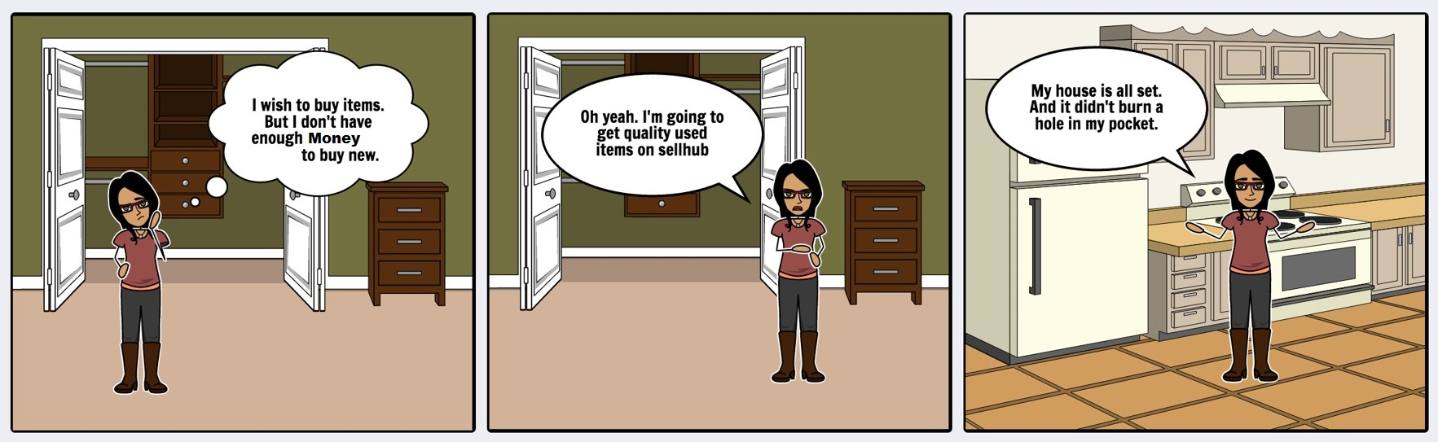
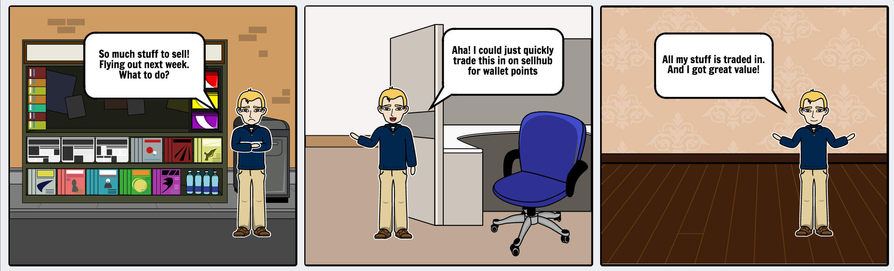
Storyboarding

Slide 8
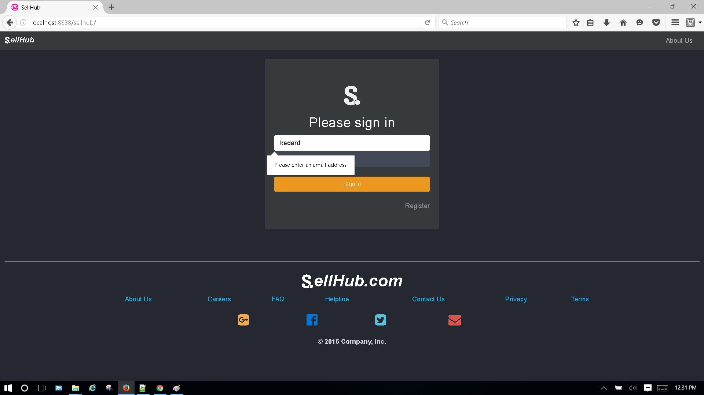
Error Handling
Prevention for invalid email addresses

Slide 9
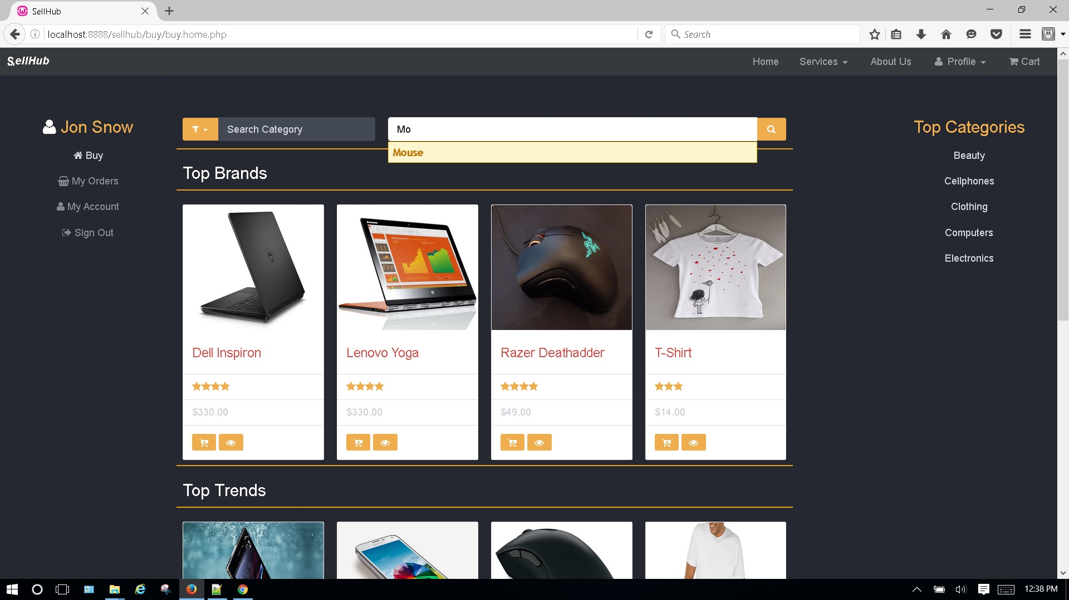
Correction using autocomplete

Slide 10
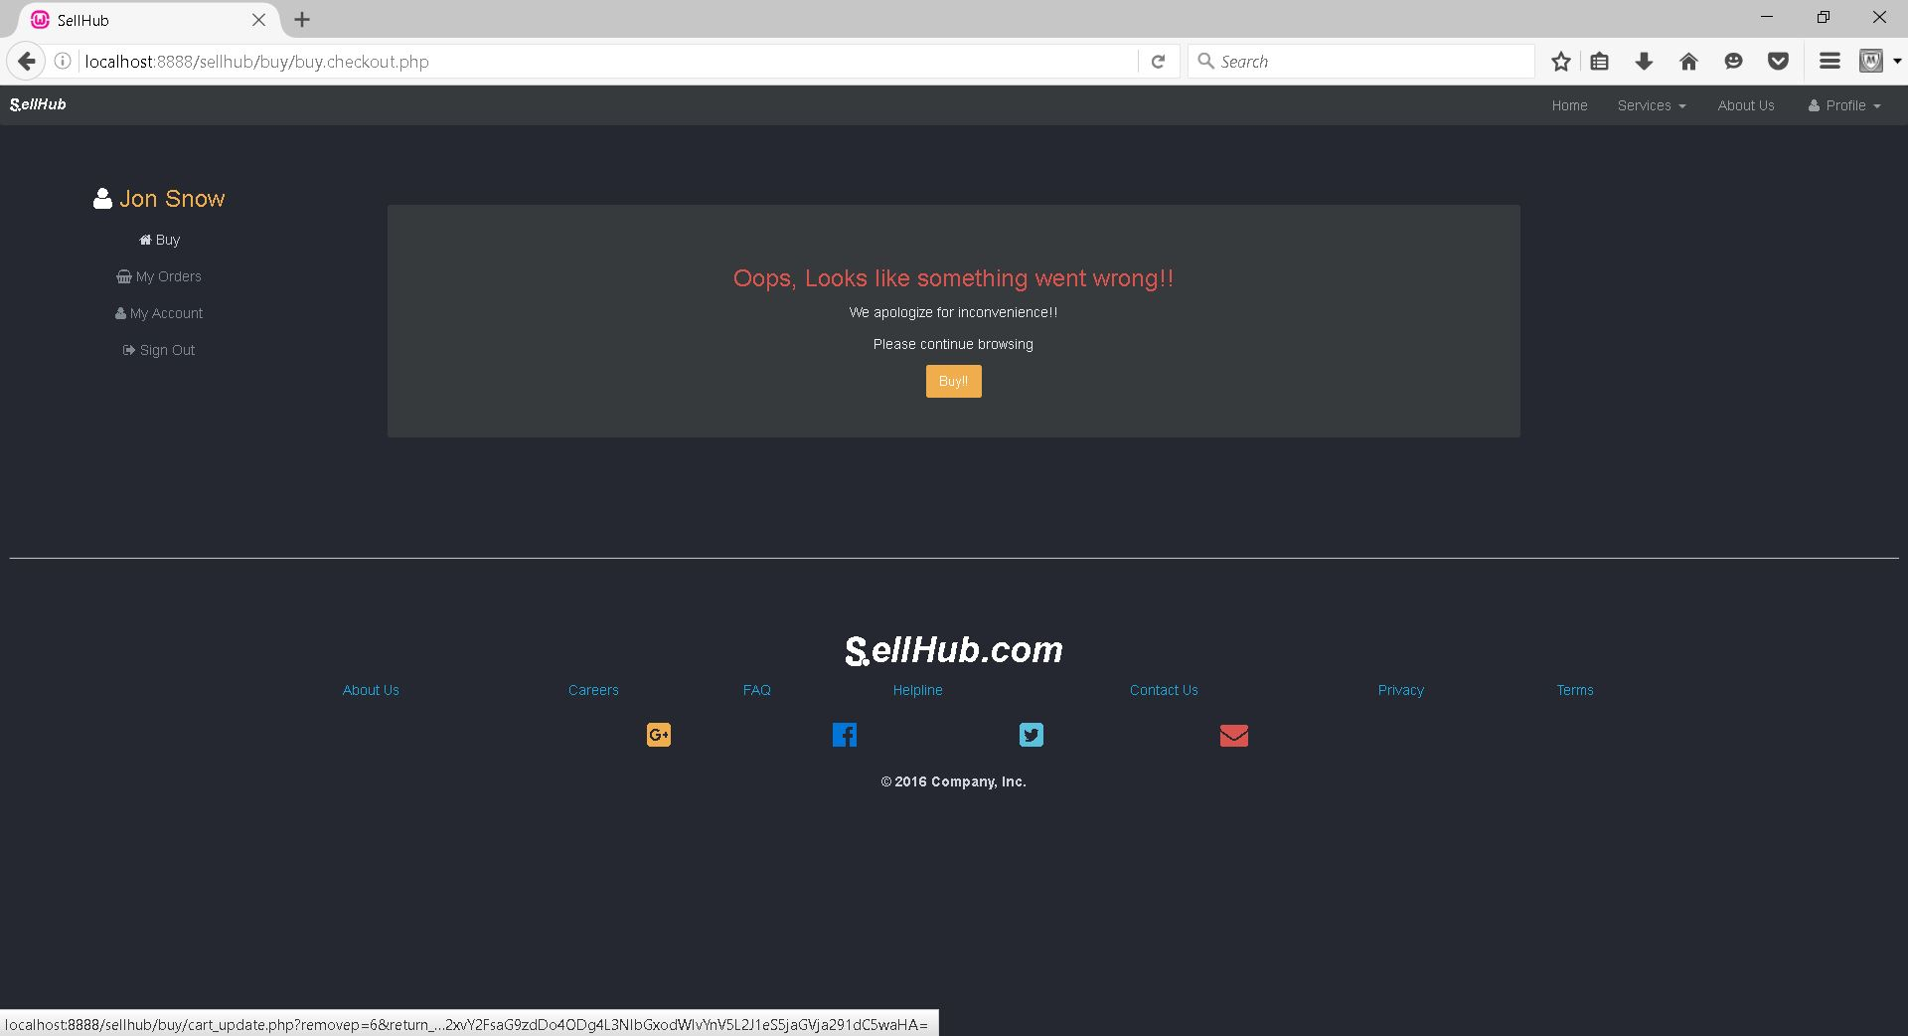
Recovery
Error Message in case of exempted actions

Slide 11
Skeleton and Surface Plane
Navigation Design
Wireframes
Contrast and Uniformity
Color Palettes and typography
User Experience Methods
User Acceptance Testing
Prototyping

Slide 12
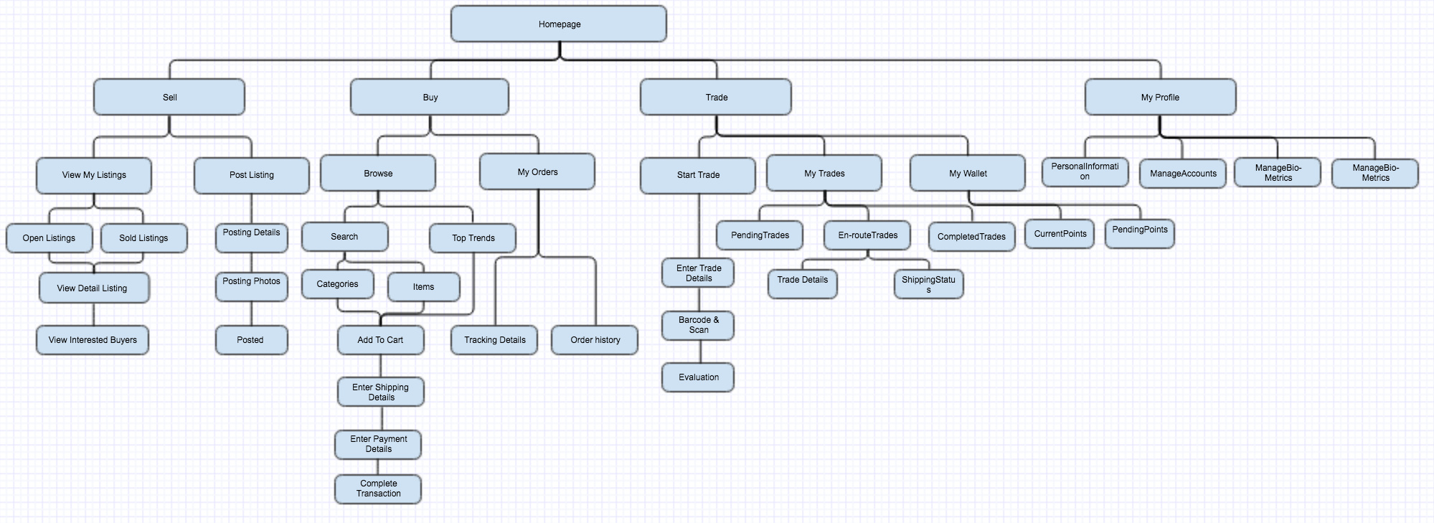
Navigation Design

Slide 13
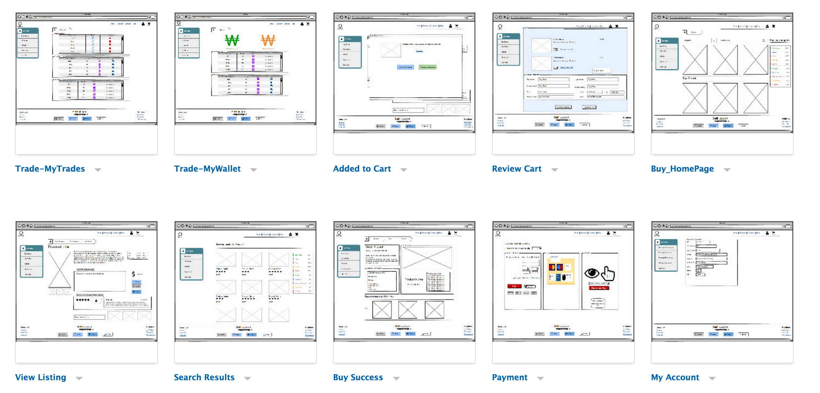
Wireframes

Slide 14
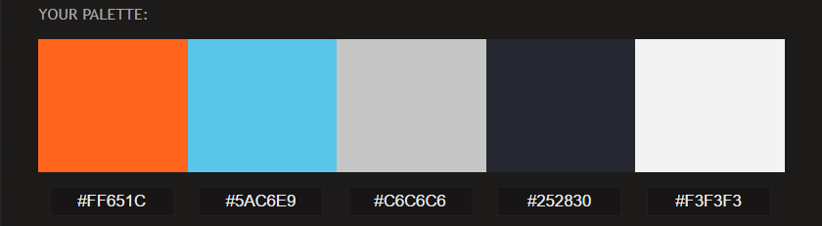
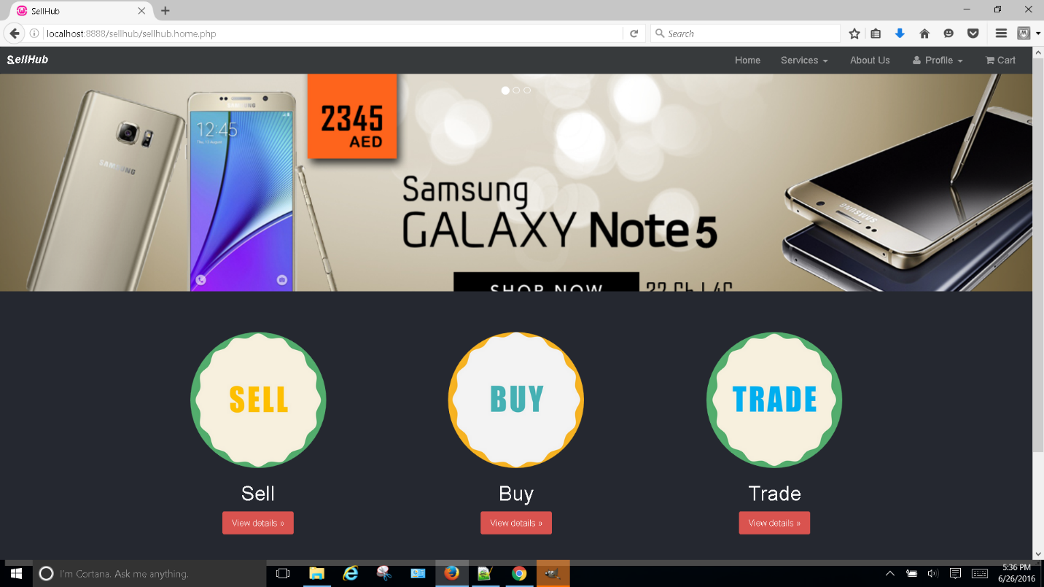

Contrast and Uniformity Color Palette and Typography
Element | Recommendation
Font | Helvetica Neue
Icons | Fontawesome.io

Slide 15
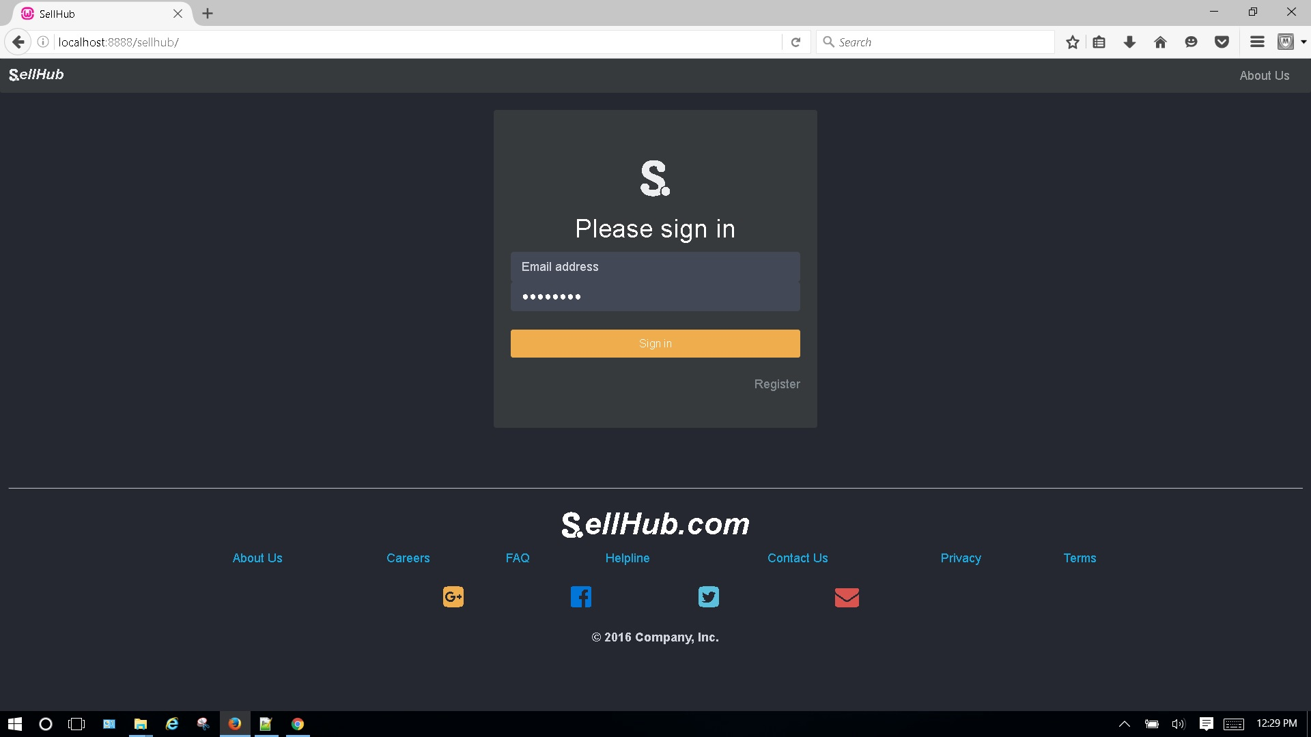
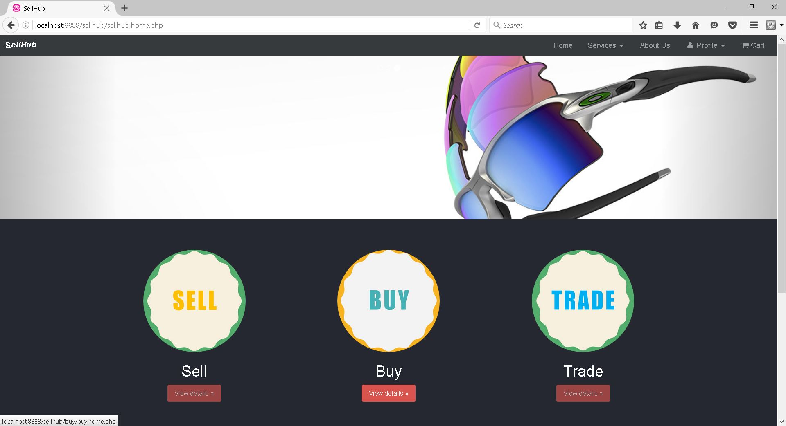
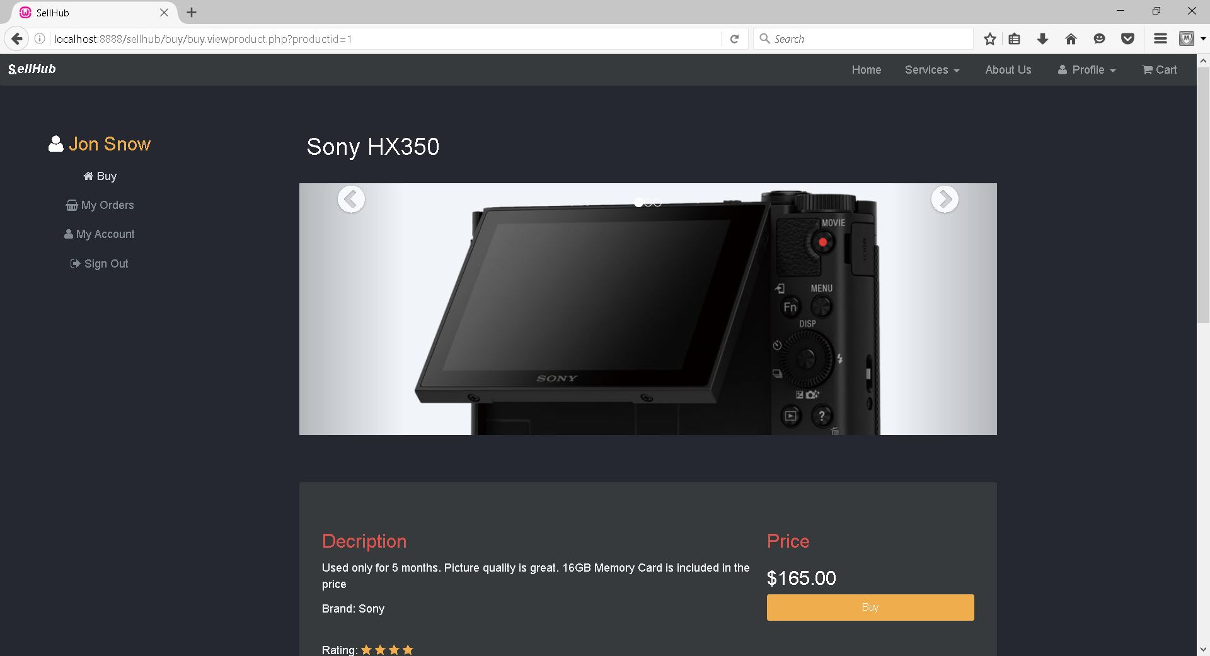
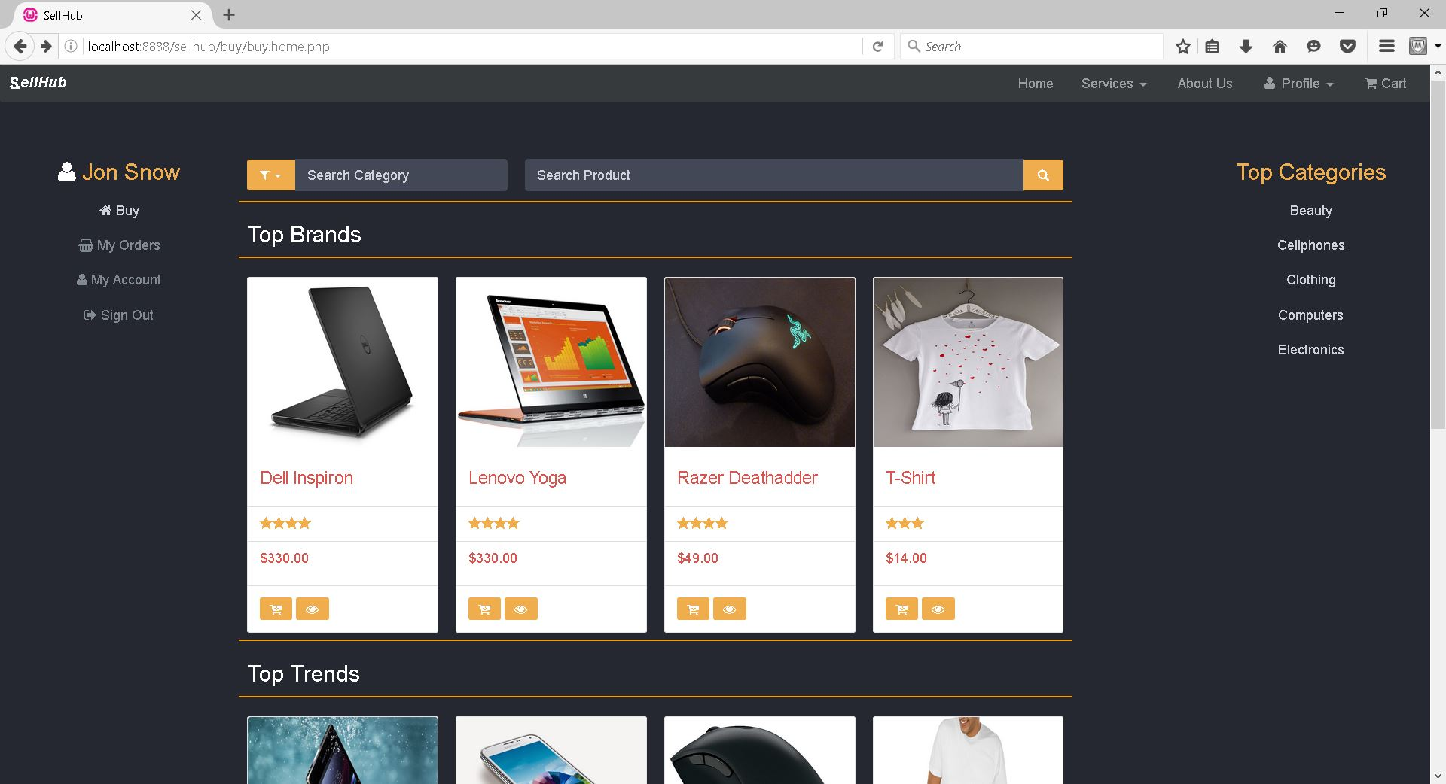
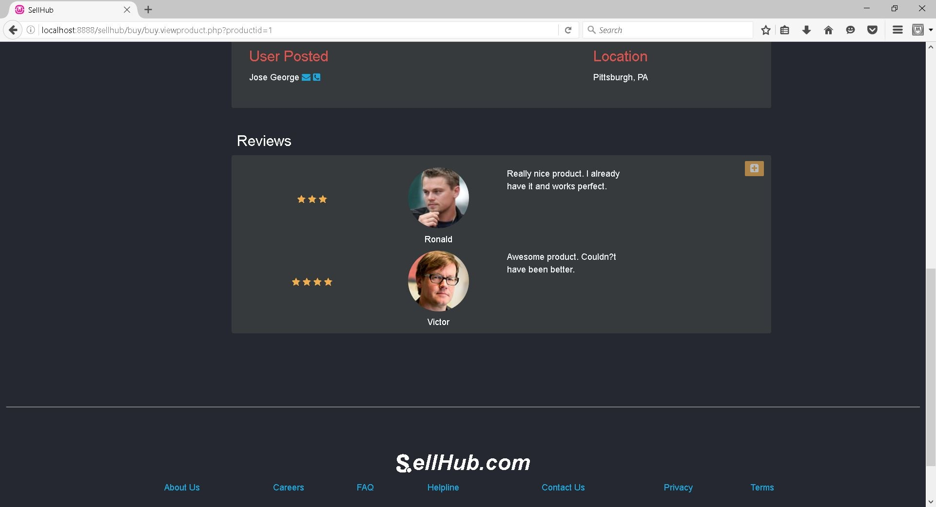
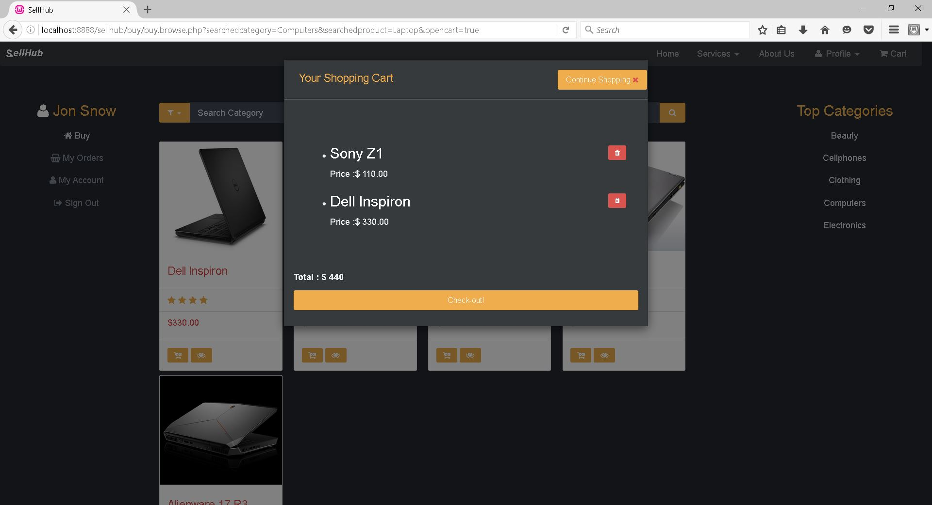
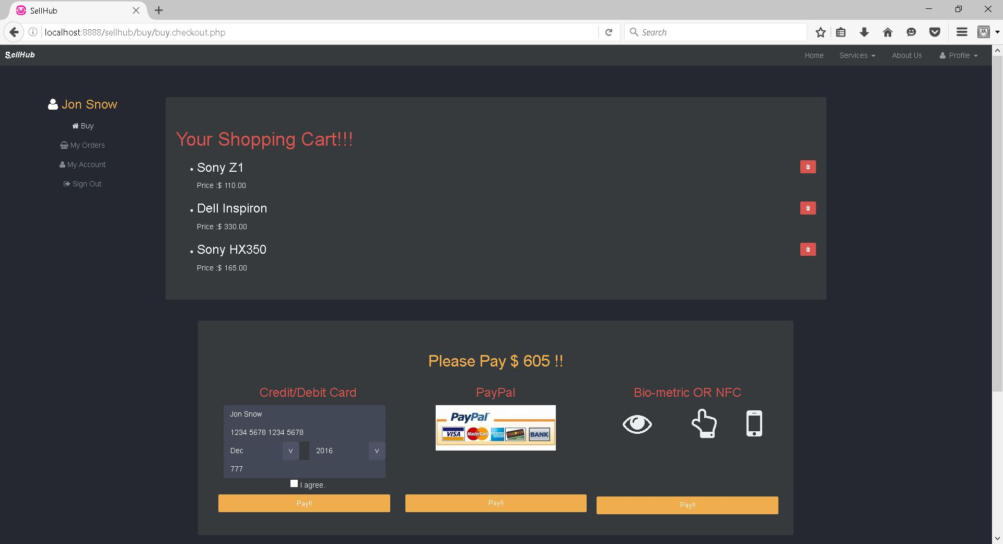
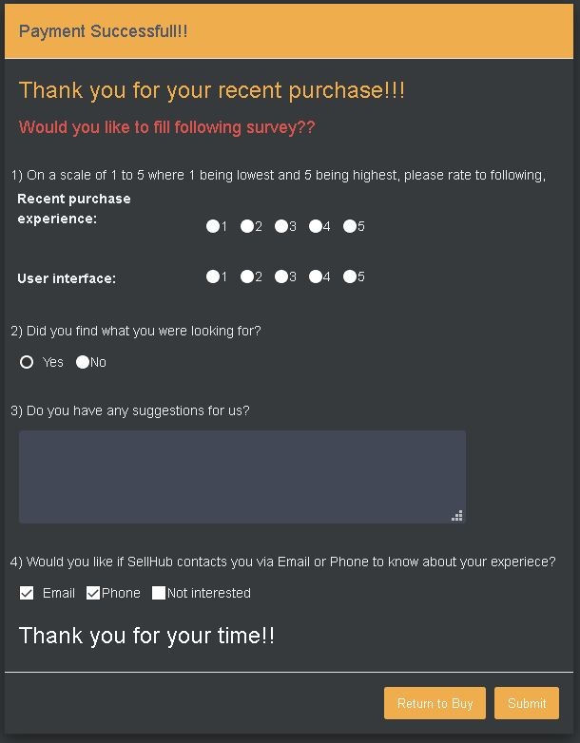

Slide 16
UX methods
Eye Tracking
Intercept Surveys
Card Sorting
Focus groups
Usability Lab studies

Slide 17
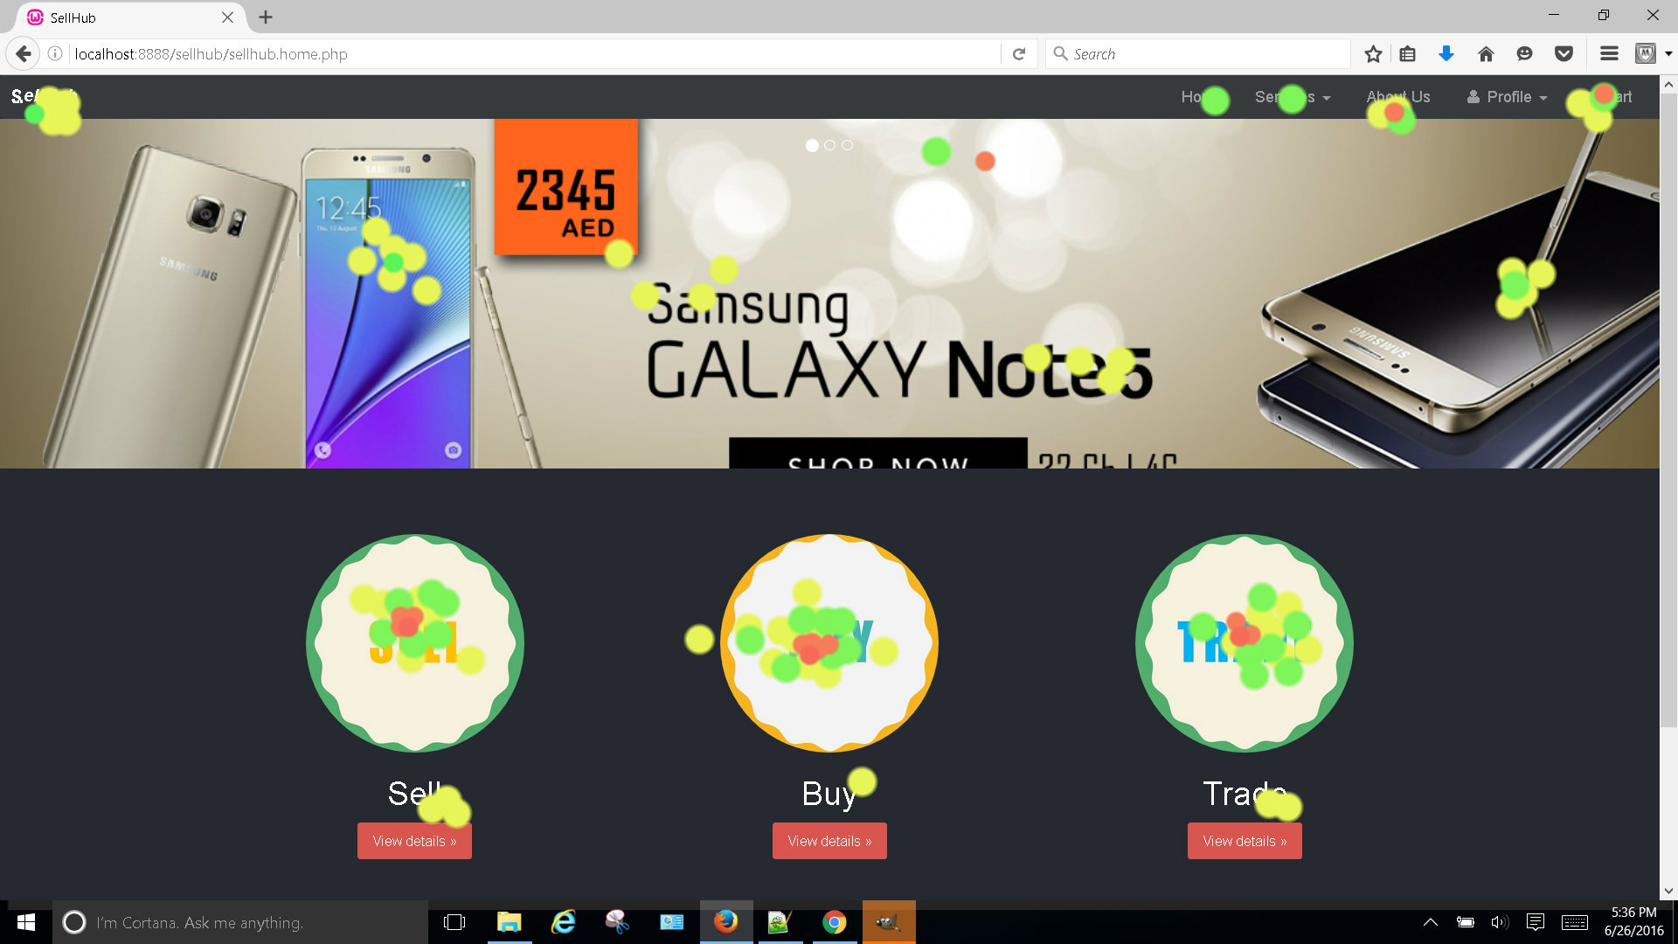
Eye Tracking
Eye tracking tracks the user’s eye movement and lets us know the focus areas
We surveyed 10 participants
Location of elements changed to achieve intended outcome

Slide 18
Intercept Surveys
Intercepting the regular flow of the user
Not causing a block in the flow.
Smoothly Transitioning

Slide 19
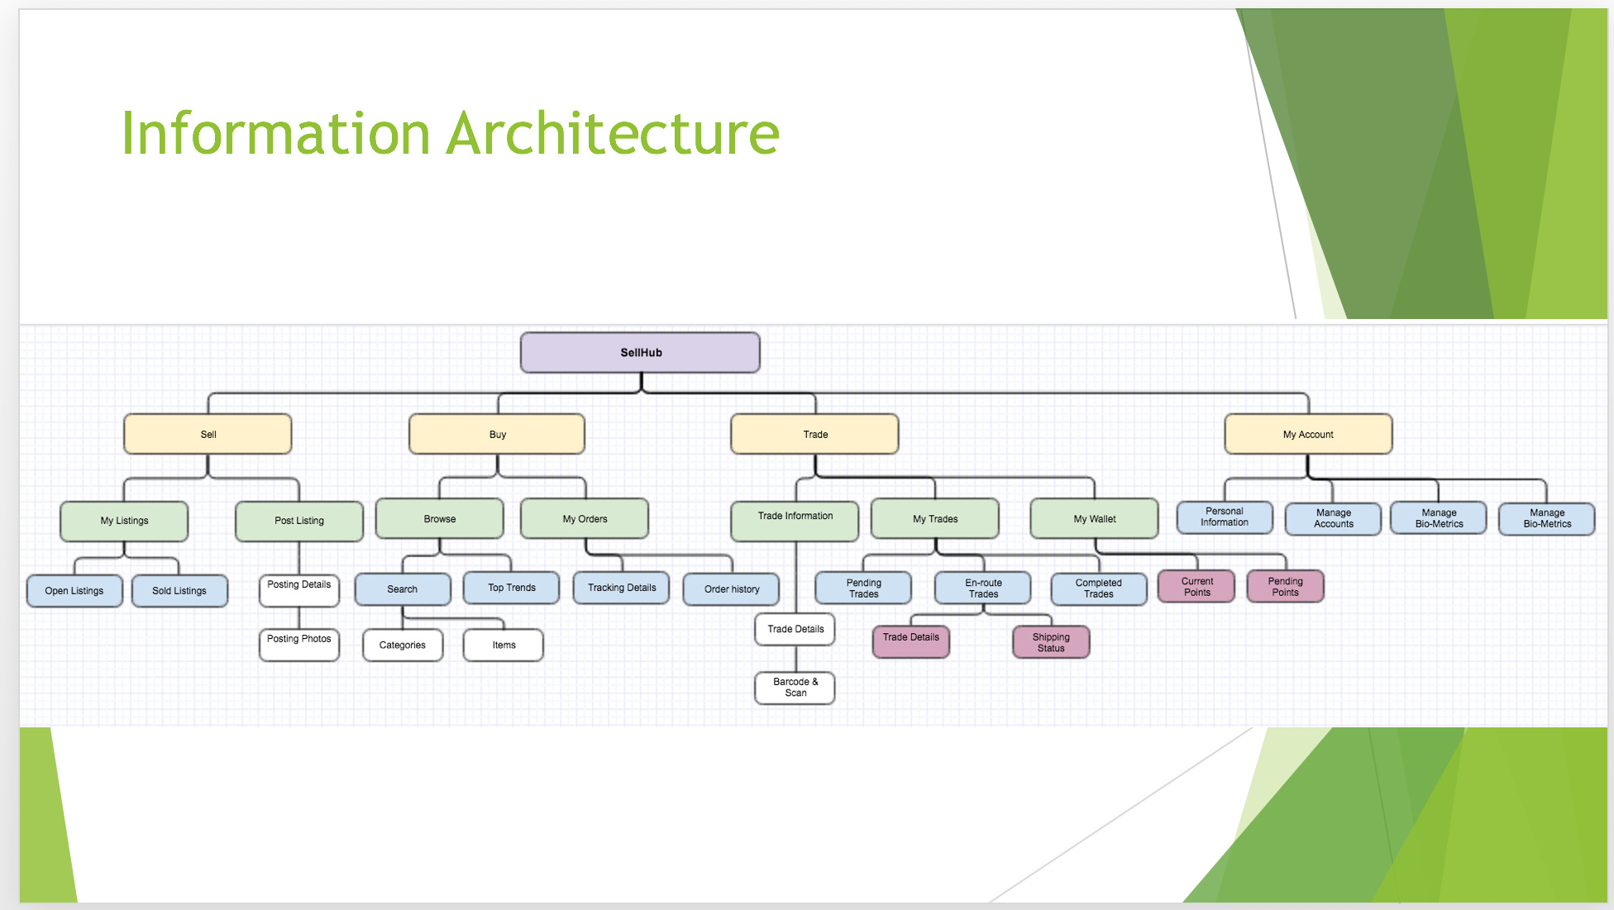
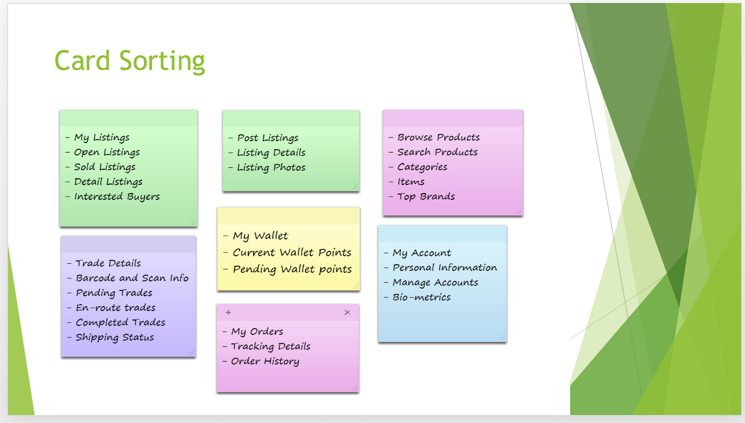
Card Sorting

Slide 20

Focus groups
Discussion with 9 participants on Abstract topics related to site.
Feedback taken into consideration while designing site.
Functionality debate and understanding user expectations.

Slide 21
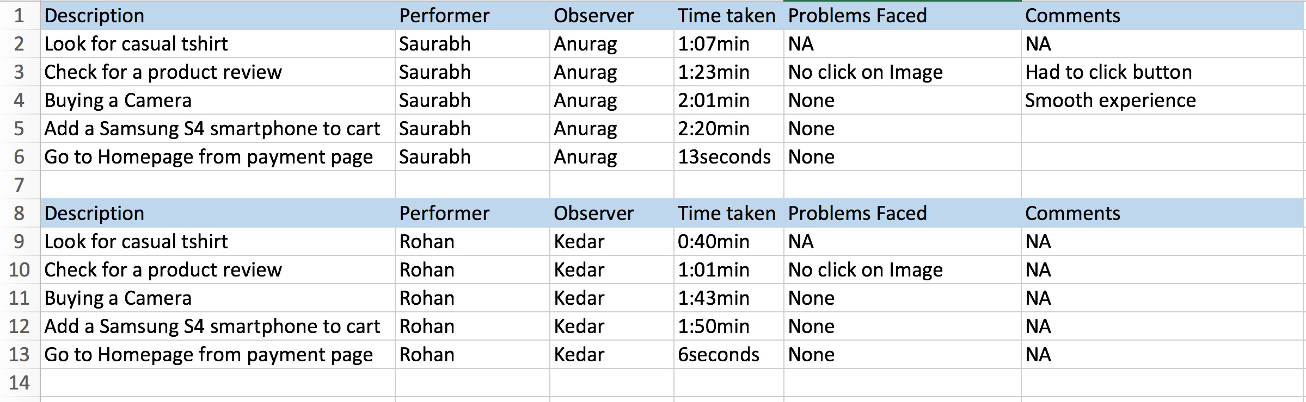
Usability Lab Studies

Slide 22
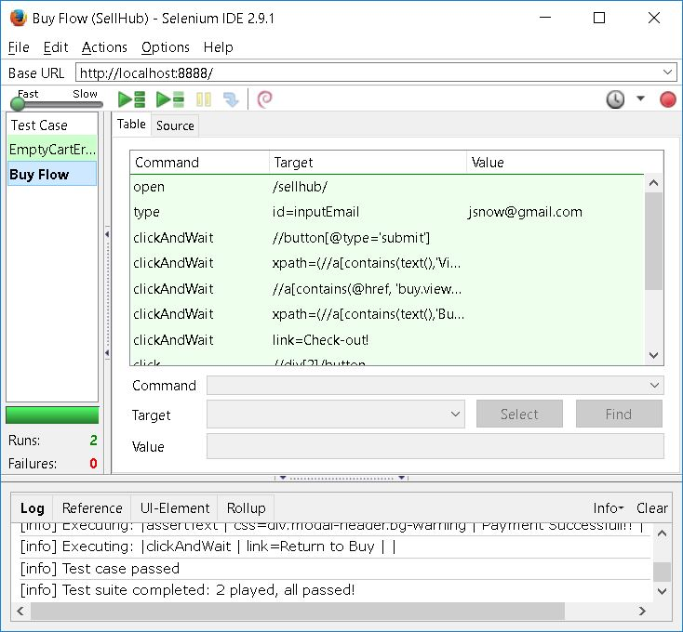
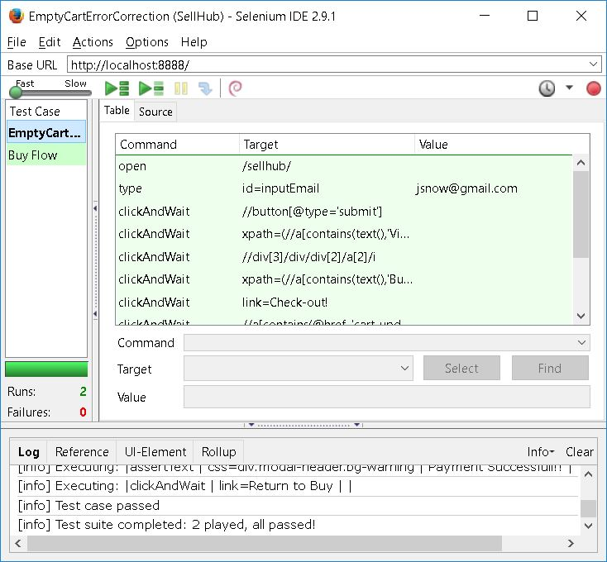
Automated Testing using selenium
Test Cases using Selenium browser IDE

Slide 23
Prototyping And Tools
Bootstrap V4
PHP
MySQL
jQuery
AJAX
WAMP Server
Storyboardthat
Balsamiq
Selenium
Xtensio

Slide 24
Thank you

